Slide 1
32nd Annual John O’Bryan Mathematics Contest
Two-Person Speed Competition

Slide 2
Basic Rules
Eight Questions; Three Minutes Each
NO CALCULATORS on the First Four Questions!
One Answer Submission Allowed Per Question; To Submit, Fold Answer Sheet and Hold Above Your Head for the Proctor; Answer must be submitted within 5 seconds of timer in order to count.
Scoring (Each Problem)
First Correct Answer = 7 points
Second Correct Answer = 5 points
All Other Correct Answers = 3 points

Slide 3
The Next Slide Begins The Competition.
This is a timer example:

Slide 4
Question 1 (NO CALCULATORS)
Let $f\left(x\right)=4x^{2}−5x+3$ and $g\left(x\right)=3x−6$.
Find the value of $f\left(g\left(4\right)\right)+g(f\left(4\right))$.

Slide 6
Question 1 (Answer)
252

Slide 7
Question 2 (NO CALCULATORS)
An ellipse has an equation of $\frac{{(x−4)}^{2}}{256}+\frac{{(y+3)}^{2}}{361}=4$.
The area of this ellipse can be expressed in the form of $nπ$. Find the value of $n$.

Slide 9
Question 2 (Answer)
1216

Slide 10
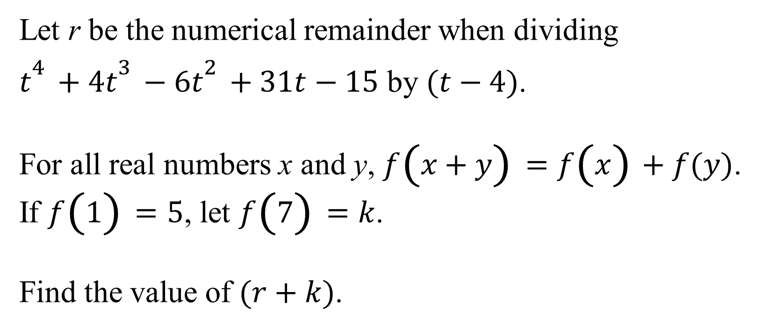
Question 3 (NO CALCULATORS)
Let r be the numerical remainder when dividing
$t^{4}+4t^{3}−6t^{2}+31t−15$ by $(t−4)$.
For all real numbers x and y, $f\left(x+y\right)=f\left(x\right)+f(y)$.
If $f\left(1\right)=5$, let $f\left(7\right)=k$.
Find the value of $(r+k)$.

Slide 12
Question 3 (Answer)
560

Slide 13
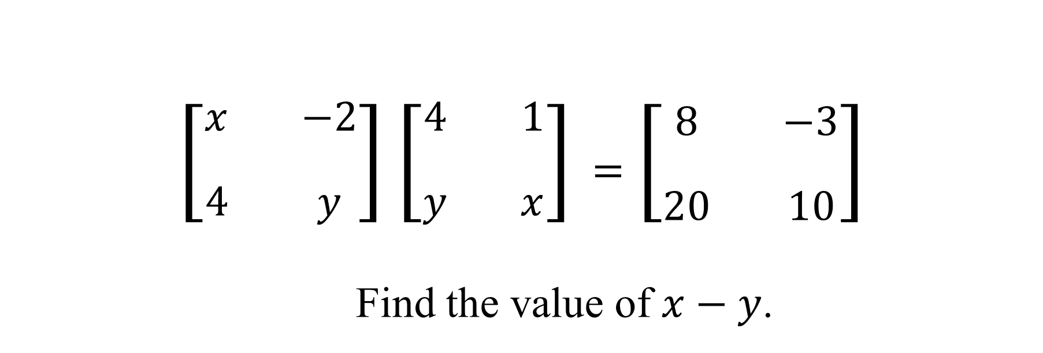
Question 4 (NO CALCULATORS)
$$\left[\begin{matrix}x & −2 \\ 4 & y\end{matrix}\right]\left[\begin{matrix}4 & 1 \\ y & x\end{matrix}\right]=\left[\begin{matrix}8 & −3 \\ 20 & 10\end{matrix}\right]$$
Find the value of $x−y$.

Slide 15
Question 4 (Answer)
1
You may use calculators beginning with the next question.

Slide 16
Question 5 (CALCULATORS ALLOWED)
A sum of $5,000 is invested at an interest rate of 10% annual percentage rate. If compounded quarterly, in how many years will that sum be worth at least $24,000.

Slide 18
Question 5 (Answer)
16

Slide 19
Question 6 (CALCULATORS ALLOWED)
Let $k$ be the sum of all positive integers x such that $\left(x−2\right)\left(x^{2}−15x+32\right)<0$.
Let $w$ be the length of a radius of a circle whose circumference contains the same number of units as its area contains square units.
Find the value of $(k+w)$.

Slide 21
Question 6 (Answer)
78

Slide 22
Question 7 (CALCULATORS ALLOWED)
Let $k$ and $w$ be positive integers where $k>w$. Find the number of distinct ordered pairs ($k,w$) that exist such that $\sqrt{k}+\sqrt{w}=27$

Slide 24
Question 7 (Answer)
13

Slide 25
Question 8 will be the final question. Proctors will keep and total your answer sheets after you submit this question.
Please remain in your seats until totals have been verified, as ties among the top three positions would be broken with tie-breaker questions.

Slide 26
Question 8 (CALCULATORS ALLOWED)
Let the volume of a cone with its height equal to its radius be 576π. The area of its base is kπ.
Let the diagonal of a cube be of length 15. The area of one of its sides is j.
Find the product jk.

Slide 28
Question 8 (Answer)
10800
This ends the competition unless there are ties; please remain while proctors total the scores.

Slide 30
Tiebreaker 1 (CALCULATORS ALLOWED)
If x is an integer such that 7 ≤ x ≤ 21, find the sum of all distinct values for i such that 441x is the square of an integer.

Slide 32
Question T1 (Answer)
210

Slide 33
Tiebreaker 2 (CALCULATORS ALLOWED)
Find the value of .
Give your answer as an exact decimal.

Slide 35
Question T2 (Answer)
22.5

Slide 36
Tiebreaker 3 (CALCULATORS ALLOWED)
Find the sum of the solutions to the equation $x^{3}+4x^{2}−9x−36=0$.

Slide 38
Question T3 (Answer)
-4

